Slide 1
CS 547
Week 1 Day 1
Tools Installation

Slide 2
Agenda
Announcements
Review of course syllabus and content
Installation of Development Tools

Slide 3
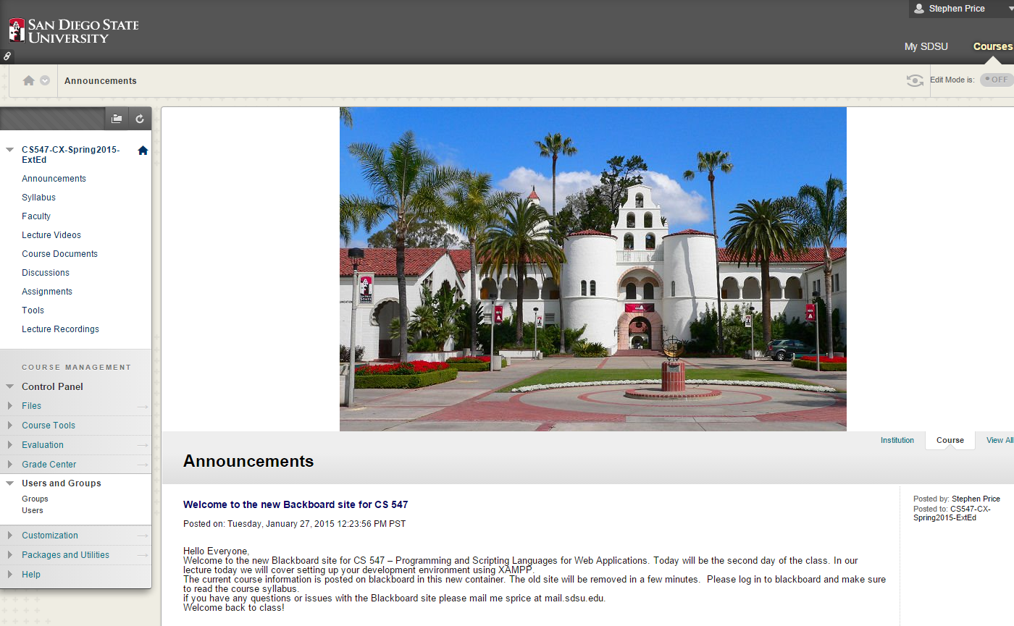
Announcements
New black board container for course

Slide 4
Syllabus
Syllabus is accessible from the black board container

Slide 5
Development Tools
We will be using a full stack development environment named XAMPP from apachefriends

Slide 6
Dev Tools: XAMPP
XAMPP is a cross platform popular development platform,
X == Windows, OS X, or Linux platform
A == Apache Web server
M == MySQL data base
P == PHP, Perl, and Later we will add Python

Slide 7
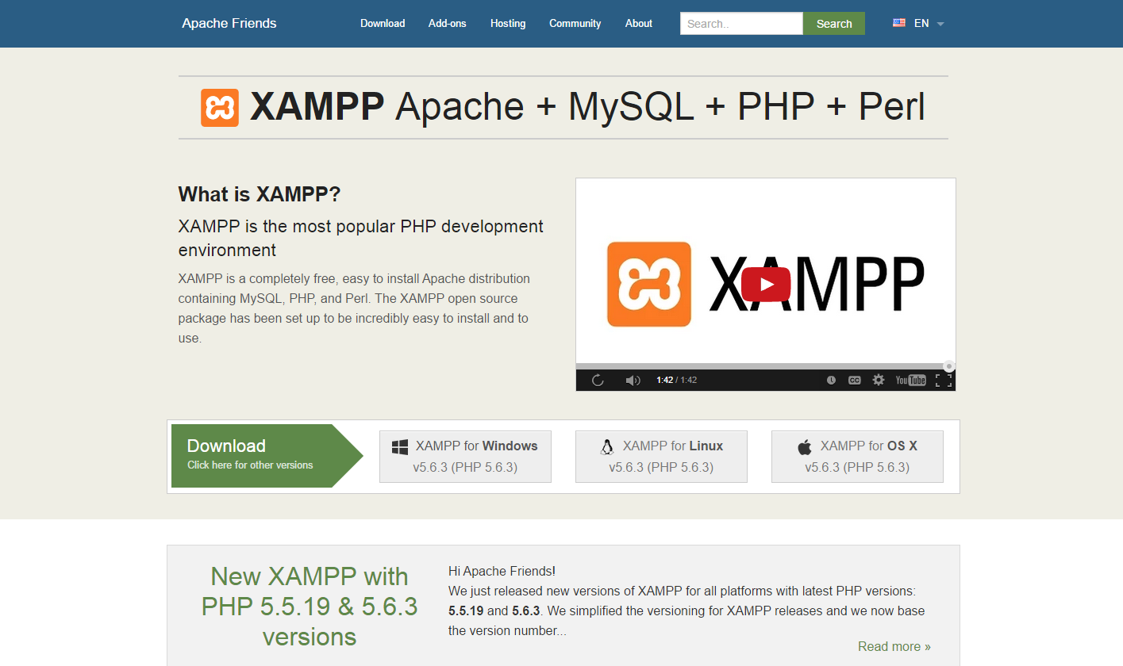
Dev Tools: Download
Download XAMPP from ApacheFriends.Org web site.

Slide 8
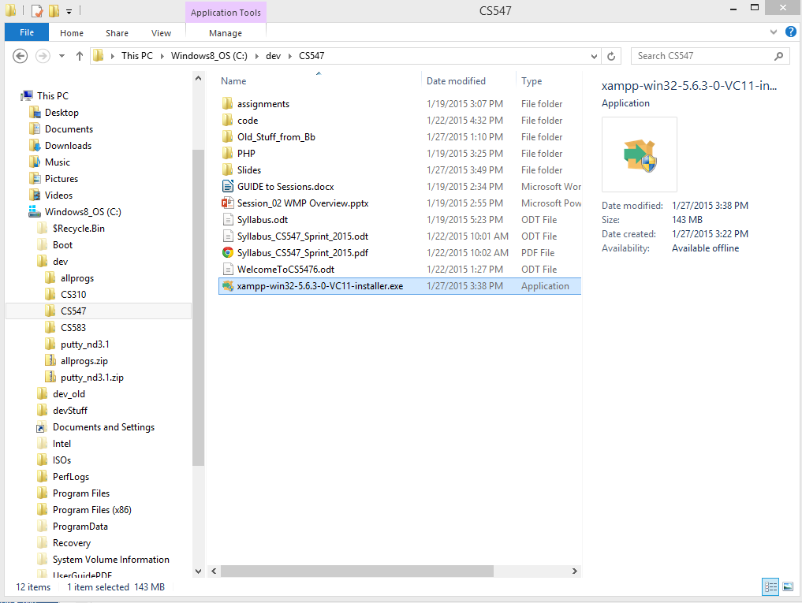
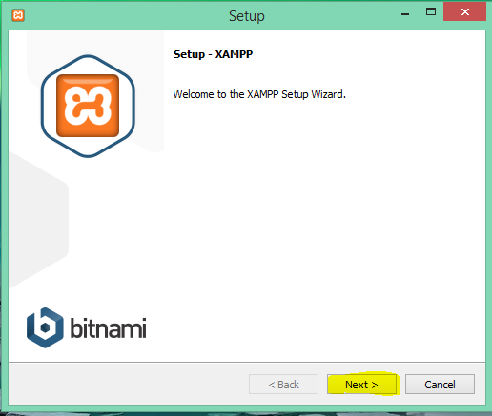
Dev Tools: XAMPP Installer
Note, the istaller will bother you about user permissions
And having anti virus software running

Slide 9
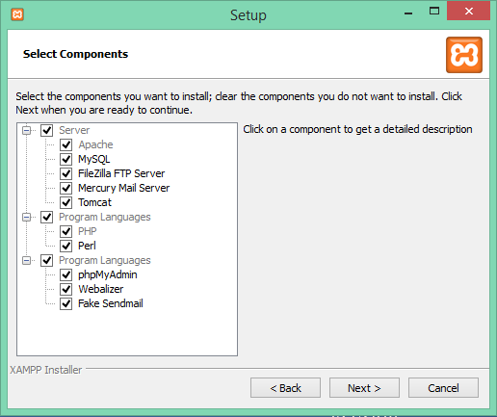
XAMPP Installer
Select the options you want to install…

Slide 10
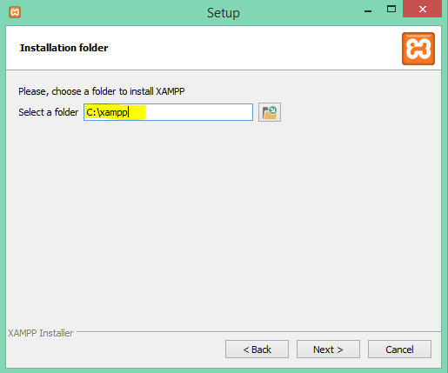
XAMPP Installer
Select the folder where you want to install.

Slide 11
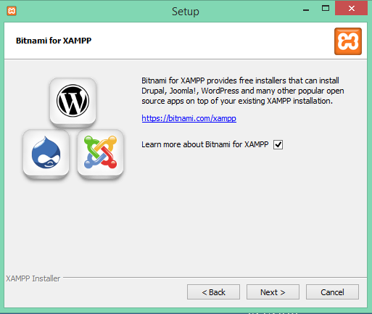
XAMPP Installer
Learn about optional packages. These are not used in our class.

Slide 12
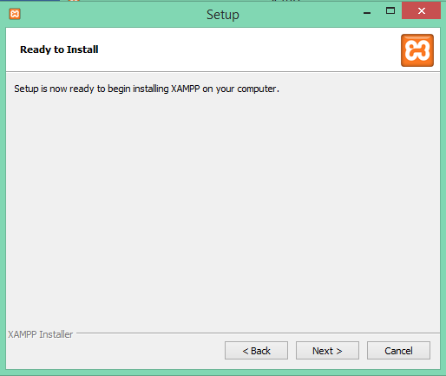
XAMPP Installer
Ready
Set
Go!

Slide 13
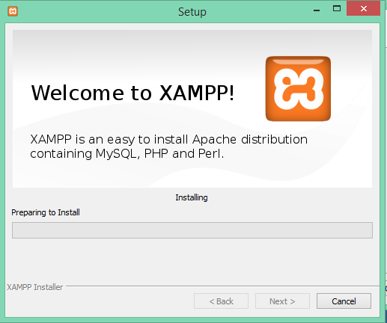
XAMPP Installer
Wait till it finishes.

Slide 14
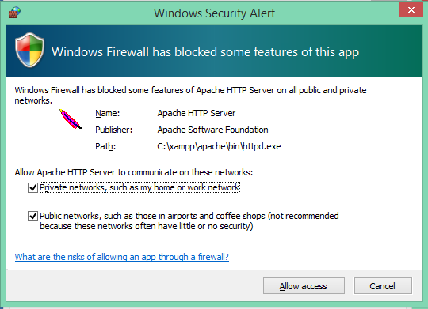
XAMPP Installer
You may see something like this…
Choose wisely!

Slide 15
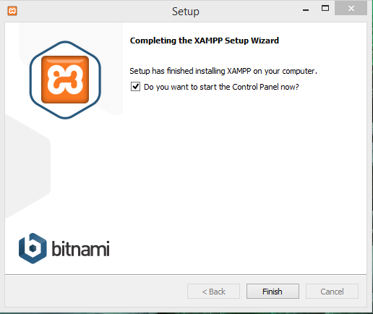
XAMPP Installer
Are we there yet???
Yes!

Slide 16
XAMPP Installer
Now what do we do?
depends on your OS…

Slide 17
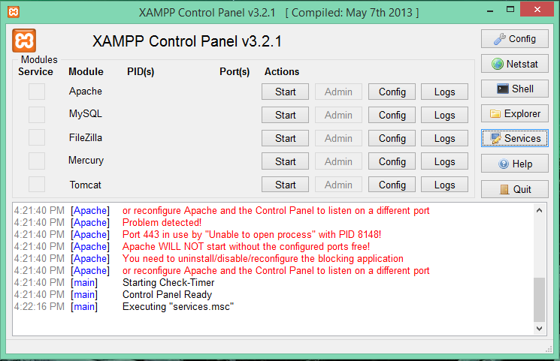
XAMPP Control Panel
To the rescue!
Use to start, stop and configure basic functionality

Slide 18
XAMPP Live Demo
Switch to XAMPP Control Panel for live demonstration

Slide 19
PHP Language

Slide 20
PHP Language
PHP – an acronym that stands for PHP: Hypertext Preprocessor
Originally called the Personal Home Page

Slide 21
PHP Language
Server side language
Type less language
Very powerful use for building dynamic web sites

Slide 22
PHP Syntax
PHP files are text files that end in a .php extension
PHP code lives in a php file and is inbetween the php script delimeters
<?php
echo “hello class”;
?>

Slide 23
PHP Language: Comments
PHP uses ‘c’ style comments
Single Line using // This is a comment
Single Line using # # This is also a comment
Block using /* … */ /*
This is a
block comment
section.
*/

Slide 24
PHP Language Case Sensitivity
In php all keywords (e.g. if, else, while, echo, etc.), classes, functions, and user-defined functions are NOT case-sensitive.
<?php
ECHO "Hello Class”;
echo "Hello Class”;
EcHo "Hello Class”;
?>

Slide 25
PHP Language Case Sensitivity
However; all variable names are case-sensitive.
<?php
$color = "red";
echo "My car is " . $color ;
echo "My house is " . $COLOR ;
echo "My boat is " . $coLOR ;
?>

Slide 26
PHP Variables
All variables start with a $
$index = 0;

Slide 27
PHP Variables
Because PHP is a loosely typed language one can have
$index = 1;
…
$index = “One”;

Slide 28
PHP Variable rules
Must start with the $ sign, followed by the name of the variable
Must start with a letter or the underscore character
Cannot start with a number
Only contains alpha-numeric characters and underscores (A-z, 0-9, and _ )
Variable names are case-sensitive

Slide 29
PHP Special Variables
There are several ‘magic’ Predefined constant for you in PHP
Name | Meaning
__LINE__ | The current line number of the file.
__FILE__ | The full path and filename of the file with symlinks resolved. If used inside an include, the name of the included file is returned.
__DIR__ | The directory of the file. If used inside an include, the directory of the included file is returned. This is equivalent to dirname(__FILE__). This directory name does not have a trailing slash unless it is the root directory.
__FUNCTION__ | The function name.

Slide 30
PHP Special Variables – Magic Constants
Name | Meaning
__CLASS__ | The class name. The class name includes the namespace it was declared in (e.g. Foo\Bar). Note that as of PHP 5.4 __CLASS__ works also in traits. When used in a trait method, __CLASS__ is the name of the class the trait is used in.
__TRAIT__ | The trait name. The trait name includes the namespace it was declared in (e.g. Foo\Bar).
__METHOD__ | The class method name.
__NAMESPACE__ | The name of the current namespace.

Slide 31
PHP Variable Scope
PHP has three different variable scopes:
Local – Variables defined within a function
Global– Variables defined outside a function
Static – Variable exists inside a function, but does not loose its value when execution leaves this scope.

